Slide 1
INTERNSHIP 2017
JASMINE CONTILE

Slide 2
MY PROJECT

Slide 3
My Job:
Project & self-assigned deadlines
Meetings 2-4 times a week
Research
Scheduling/Contacting my teachers

Slide 4
How was working as an intern meaningful to my education?

Slide 5
How was my work meaningful beyond school & internship site?

Slide 6
PROJECT PROCESS:

Slide 7
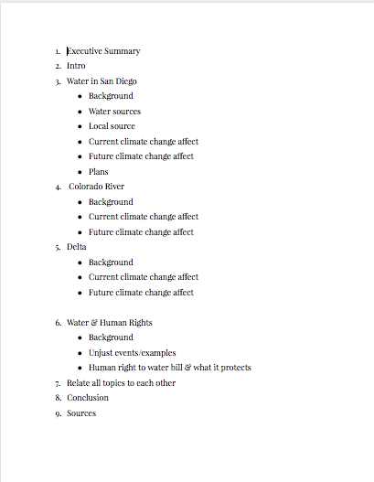
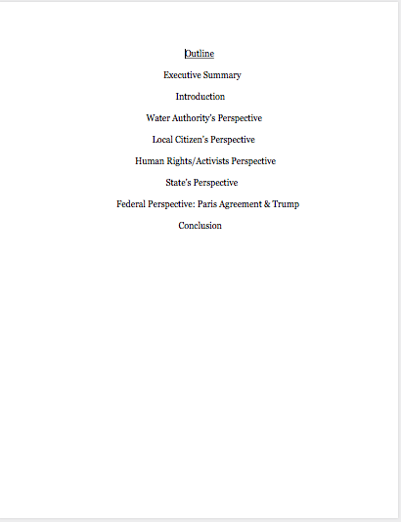
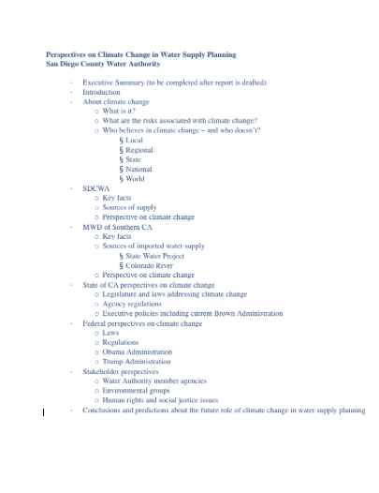
OUTLINES

Slide 8
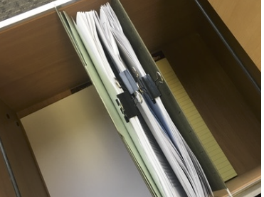
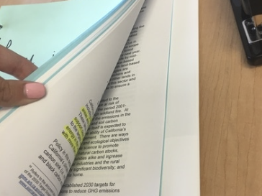
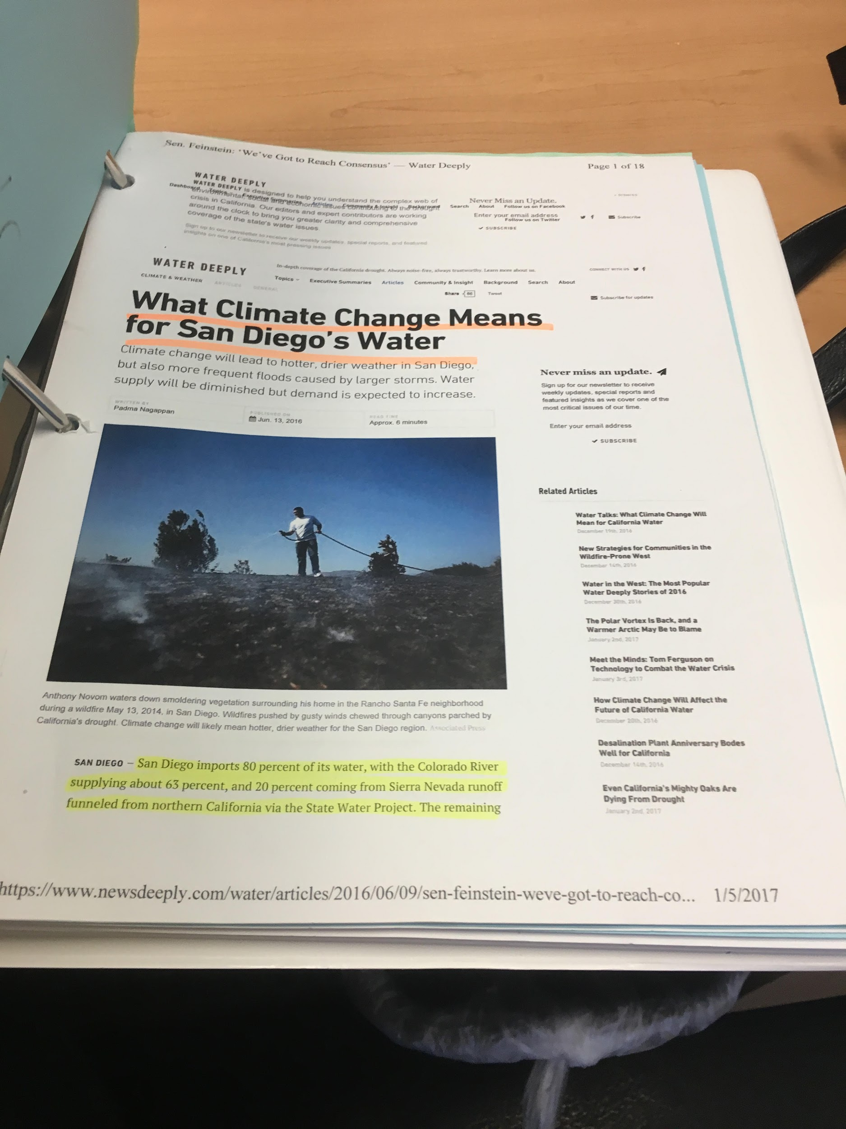
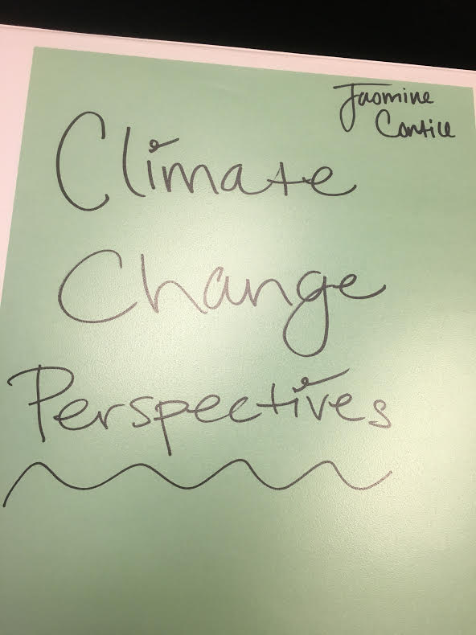
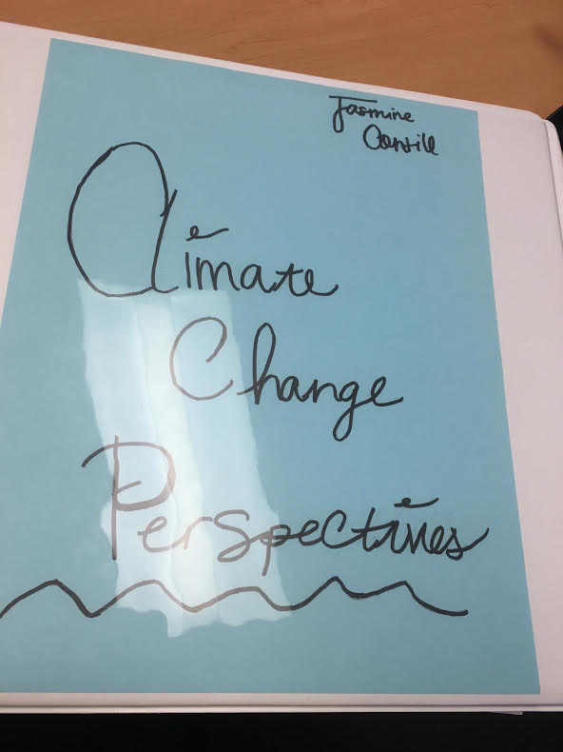
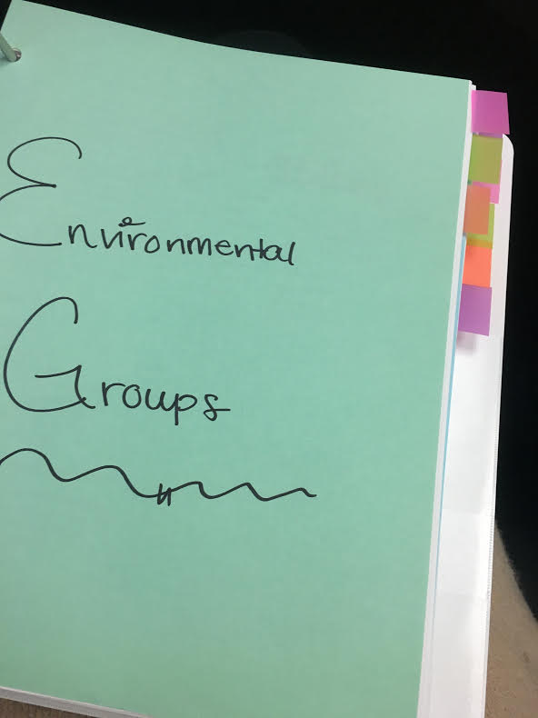
RESEARCH

Slide 9
What my paper was about

Slide 10
What did I learn about communication & self advocacy?

Slide 11
Communication & Collaboration

Slide 12
What did I learn about myself from working on my internship project?

Slide 13
LIFE OUTSIDE HIGH SCHOOL

Slide 14
WHERE DO I WANT TO GO?

Slide 15
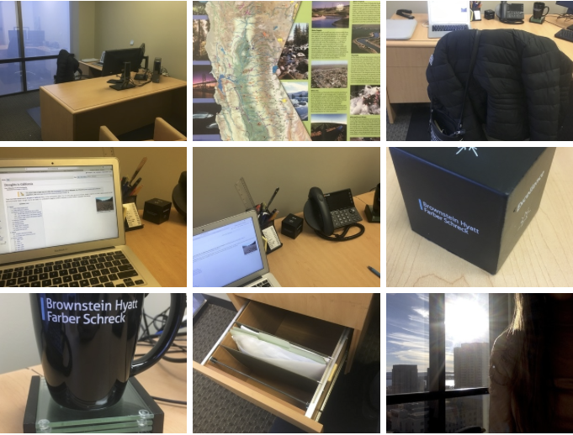

Slide 16
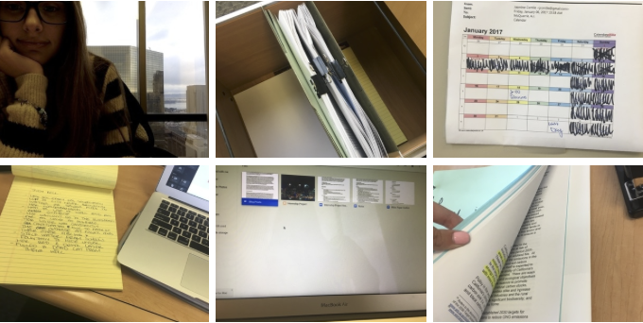

Slide 17
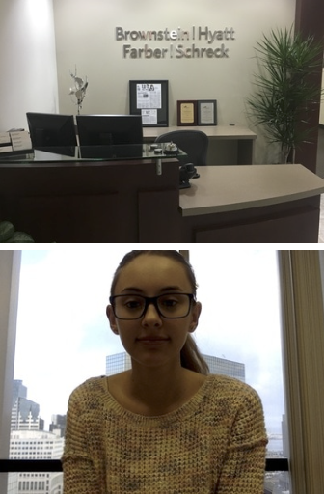
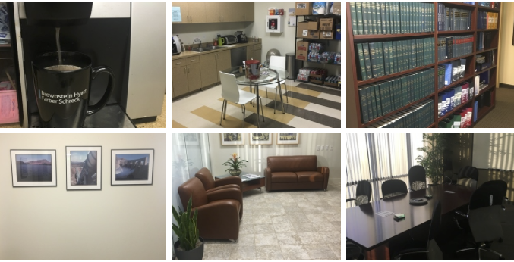

Slide 18
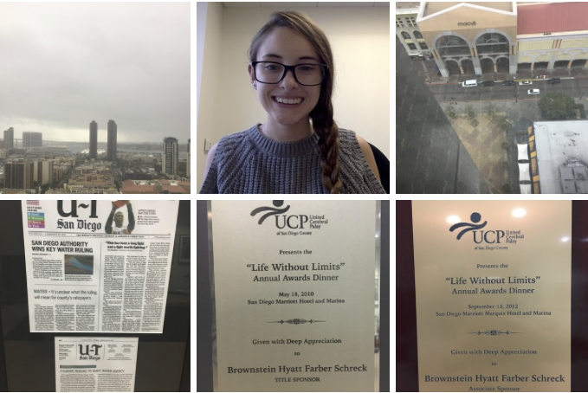

Slide 19
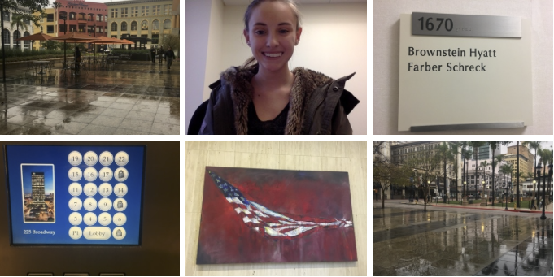

Slide 20
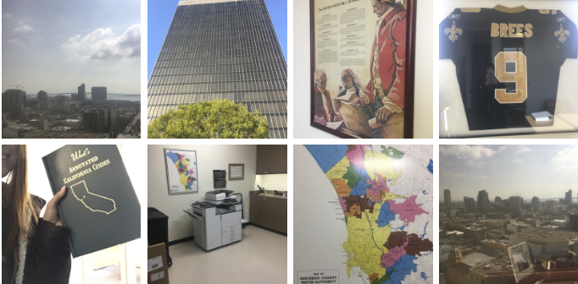

Slide 23
Questions & Discussion

